Slide 1

Population Size and Carbon Emissions
Laurent Mundell

Slide 2
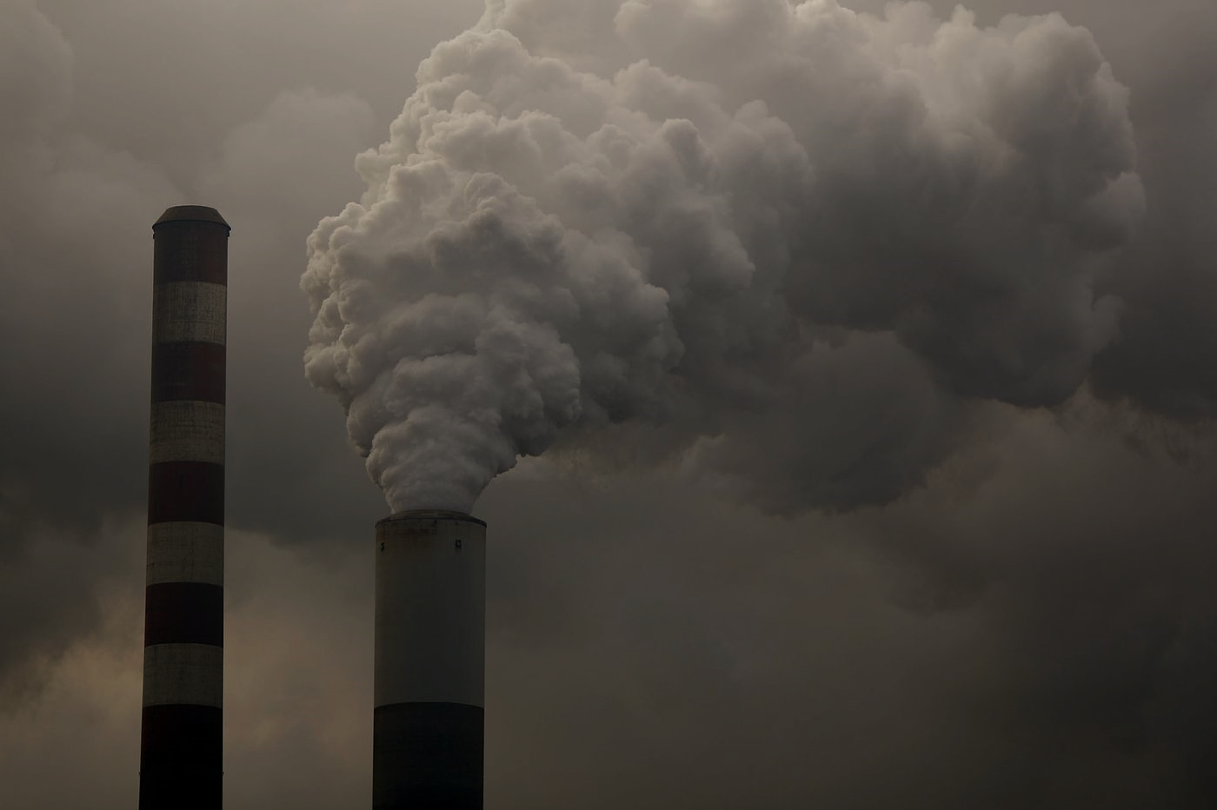
Introduction
Population projections from the US Census Bureau predicts population growth
Does the size of a region’s population significantly influence car emissions?

Slide 3

Study
In our study we looked at CO2 emissions by region & population by year.
We gathered population data for 2017 from the U.S Census Bureau and total carbon emissions for all 50 states from 2010 – 2017 from the U.S. Energy Information Administration.
We hypothesized that there is no difference between carbon emissions and population size.
https://www.eia.gov/opendata/qb.php?category=2251604
https://www2.census.gov/programs-surveys/popest/tables/2010-2019/state/totals/nst-est2019-01.xlsx

Slide 4
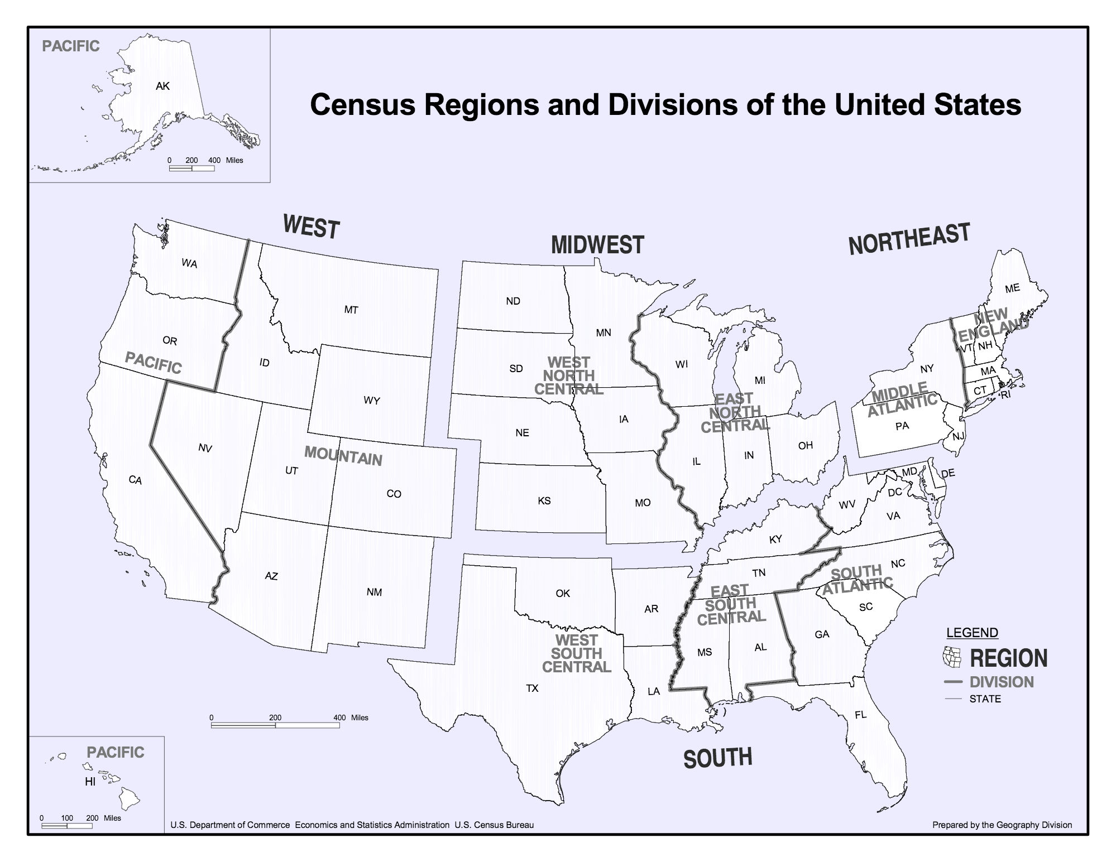
https://www2.census.gov/geo/pdfs/maps-data/maps/reference/us_regdiv.pdf

Slide 5
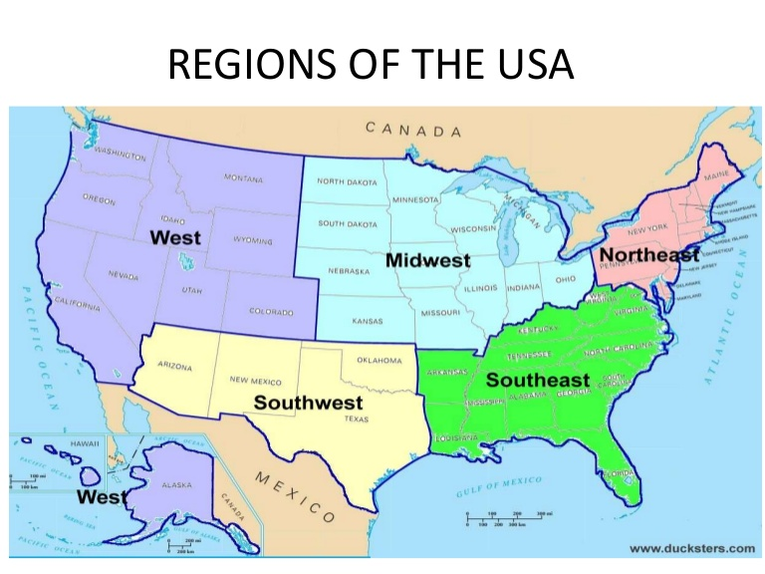

Slide 6
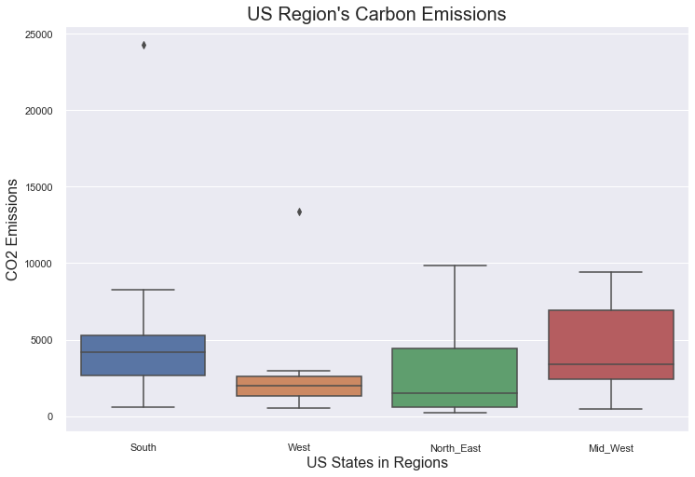

Slide 7
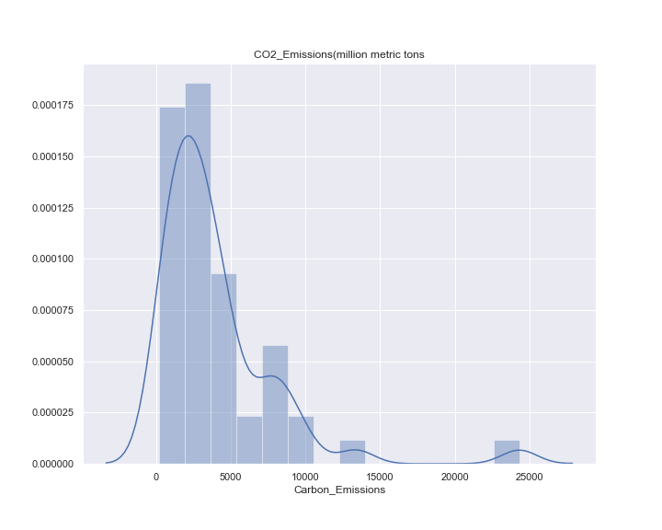
Sum carbon emissions distribution by state from 2010 - 2017

Slide 8
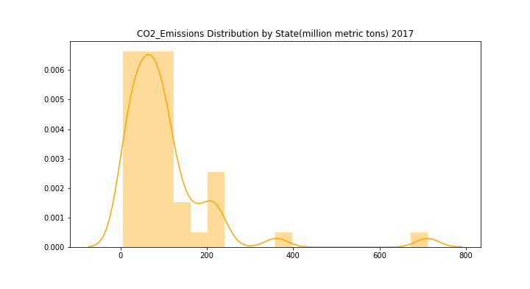

Slide 9
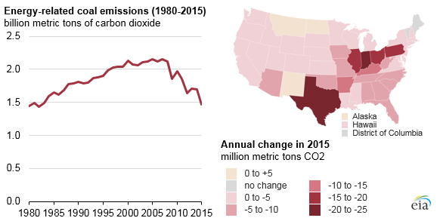
Everything is bigger in Texas
https://www.eia.gov/todayinenergy/detail.php?id=33712

Slide 10
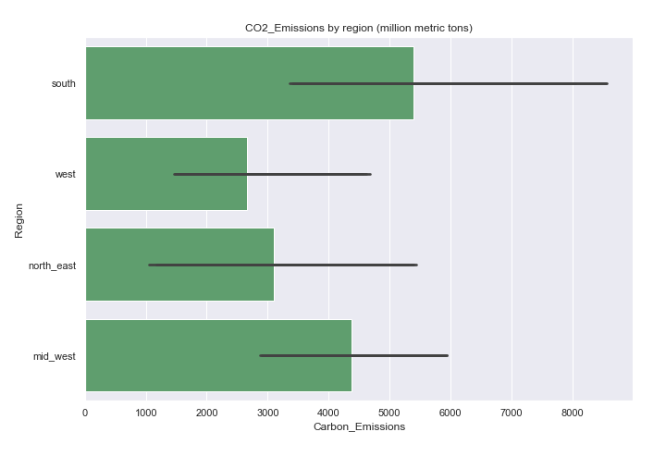

Slide 11
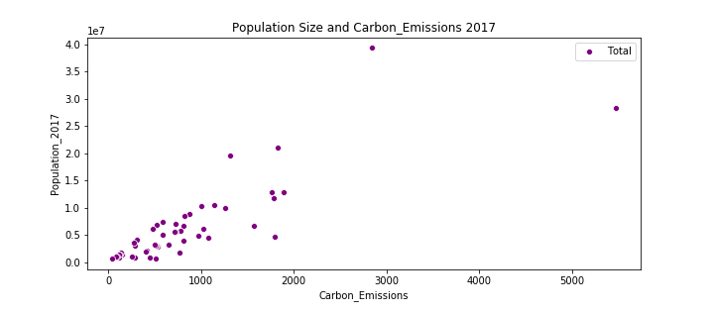

Slide 12
Conclusion
Measuring the population percentile for south, west, mid-west, north-east regions were 37%, 23%, 21%, 17%, respectively.
The carbon emission proportions showed no correlation with population leading us to say the population size does not have a significant effect on the carbon emission.

Slide 13
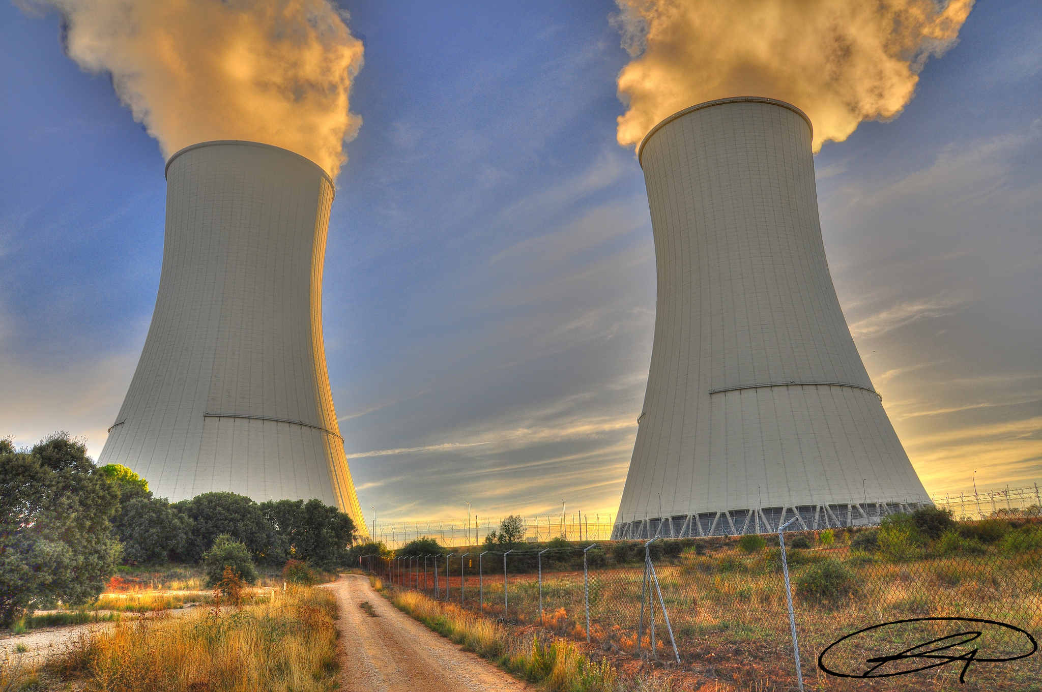
Questions?

